Slide 1

State of the art logging
Milan Vukoje
vukoje@gmail.com
www.vukoje.net
October 23rd 2013

Slide 2




Intro
Webcom www.webcominc.com
We are hiring!

Slide 3
Topics
What is tracing?
How to build it?
Logger as profiler
Logger design
Log analysis
Demo 1 – WEBCOM trace analysis GUI
Demo 2 – AOP logging in MVC with NLog and Glimpse

Slide 4

What is tracing?
How to know what is production system doing?
Why not remote debugging?
Why not profiler?
What more?
Debugging
Profiling
Notifications
logs as data
User
Admin
Dev

Slide 5

So how to build it?
Custom solution?
System.Diagnostics.Trace?
IntelliTrace?
Log4Net?
no support for CSV
no support for dynamic file naming
java port with a bit awkward code
last release in 2006
Nlog?
simple
good code
Plenty of features
side project by MS employee

Slide 6
Where to store logs?
File system
Accessibility
Cleanup
Replication
Affecting speed
Event log
Database
Cloud
App memory
web farms?
session dependency
Out of memory
Notes:
EventLog – security issues
Database – overkill, can kill db
Cloud - logentries

Slide 7
Logger as profiler
When off – no impact
When on – trivial impact
Delay messages formatting!
Avoid DateTime.Now;
Use StopWatch.GetTimeStamp();
Notes:
When tracing is turned on it should not affect app performance or else we will get incorrect performance data
Never use DateTime.Now for profiling it is slower than StopWatch and not lighweight. StopWatch is more precise.

Slide 8
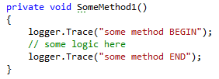
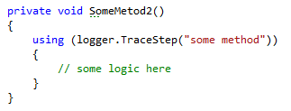
“using” vs. start/end logs
better for functions with multiple exit points
works good with exception control flow
less repeated work
better support for automatization

Slide 9
Logger design issues
Hide behind facade
Logger must not break
Should not be transactional
GUI for runtime configuration
Redundant logs
Editable logs
Logs size and cleanup
Avoid conditional tracing
Notes:
hide behind the facade to lower dependency on external component
Must not break
report errors using internal logger
NLog can turn on internal logger
writing logs must not participate in ambient transactions
Important to be possible to alter configuration at runtime
web.config is not user friendly, and will restart app
it should be possible to tracing on only for one user
Consider redundant logging events to files instead of just DB in cases when DB is not accessible.
Consider possibility to comment on EventLogs (mark as solved, enter case number etc…)

Slide 10

Log levels
Levels are not informative enough
We need more meaningful API
Trace (Low/High)
debug and performance info
Events (Info/Warn/Error/Fatal)
durable info with different types
suitable for monitoring
much less than trace
Notes:
negative events monitoring

Slide 11

Log entity data
Message/title + description
Log level
Timestamp
Exception call stack
Logger name - extracted from class name
Additional data
labels (categories)
ticks

Slide 12
Log context data
Event context
App/Tenant/User/HttpRequest…
Trace buffer
Session buffer
Trace call back and tag
Notes:
Trace buffer - last n Trace High entries
Session buffer - possibility for user to add custom data like last n visited urls

Slide 13
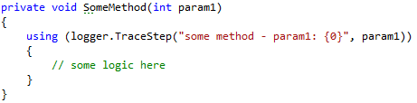

AOP vs. manual logging

Slide 14
AOP vs. manual logging
AOP
easy
too much logs
no explanations, just method names
Manual
boring
repetitive
better control
better meaning
Combine them!
Explain through logs

Slide 15
How to scope logs?
No scoping
Per app
Per server
Per tenant
Per user
Per user action
Configurable

Slide 16
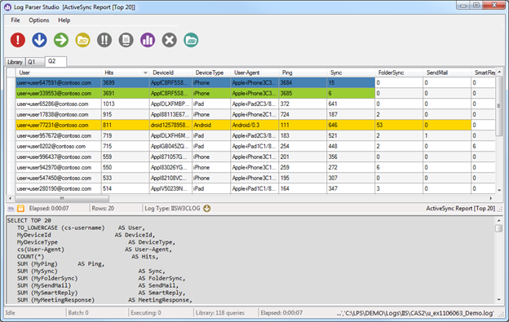
Log analysis?
Log as data
Notepad(++)
Excel (csv)
LogParser studio
Integrated app tool
Notes:
LogParser studio - excellent for standard logs

Slide 17

Demo 1 – WEBCOM trace analysis GUI
Notes:
tracing from IPython scripts
LogAnalyzer console app for excel data analysis
memory dumping with context and local variables
impersonate
lazy string evaluation
visual nesting of hierarchy data
sample - see all db queries + slowest first + total time in db
reach filtering capabilities
downloading of raw csv data for later analysis

Slide 18
Demo 2 – AOP logging in MVC web app using NLog and Glimpse
Notes:
controller actions logging wiht parameters
AOP logging for repositories
EF queries logging
TraceStep support

Slide 19

Thank you for your attention! Any Questions? www.vukoje.net vukoje@gmail.com

